Slide 1


Applied Virtual Networks
COMP 4912
Instructor: Dawood Sajjadi
PhD, SMIEEE, CISSP
ssajjaditorshizi@bcit.ca
Winter-Spring 2025
Week #8

Slide 2



RECAP
The Ansible project is an open source community sponsored by Red Hat. It uses YAML to perfectly describe IT application environments in Ansible Playbooks. Ansible Engine is a supported product built from the Ansible community project.
What Ansible Does?
Overview of Configuration Management and Automation
Implementing an agentless architecture to manage resources
Simple, YAML-based Playbooks
Agentless Approach
Scalability and Performance
Extensibility with Modules
Key Features
Notes:
Ansible provides an easy way to manage large infrastructures. It enables repeatable, reliable operations by using simple YAML files called playbooks. Its agentless design means fewer resources are consumed, and it is simple to set up. Indeed, Ansible is an open-source tool for automating IT operations. It is agentless, meaning you don’t need to install additional software on managed nodes. Ansible simplifies tasks like configuration management, application deployment, and IT orchestration.

Slide 3
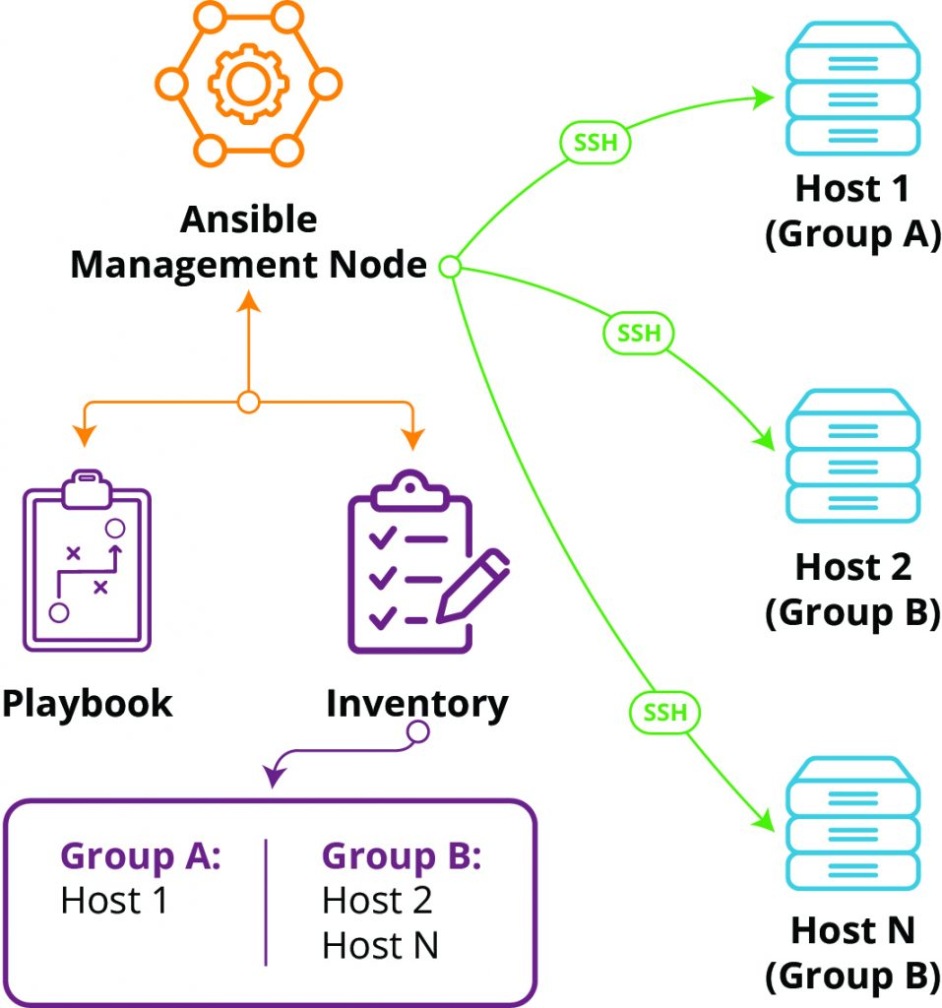
How Ansible Works
RECAP
Architecture Overview
Execution Flow of an Ansible Playbook
→ Communication via SSH
→ Mostly written in Python
→ It is Agentless (no service running)
Common Use Cases
→ Configuration Management
→ Application Deployment
→ Orchestration of Complex Workflows
Notes:
Ansible operates by connecting to managed nodes via SSH. Tasks are defined in YAML playbooks and executed on target machines in an ordered manner.
Use cases include configuration management (ensuring systems have specific states), application deployment (consistent rollouts), and orchestration of complex tasks like cluster creation.

Slide 4


Terraform, the de facto standard for IaC
RECAP
Terraform is used to create, manage, and update infrastructure resources such as virtual networks, VMs, security rules, containers, domains and more. Almost any infrastructure type can be represented as a resource in Terraform.
Declarative
Written in Go
Multiplatform
Free Software & Open Source
Freemium (Premium options: GUI, support, …)
HashiCorp Product (https://developer.hashicorp.com/terraform/intro)
It is important to note that Terraform is primarily an IaC tool, designed to provision and manage infrastructure such as servers, networks, and storage, but not to install or configure software on those servers.
Terraform does NOT replace configuration management tools like Ansible.

Slide 5
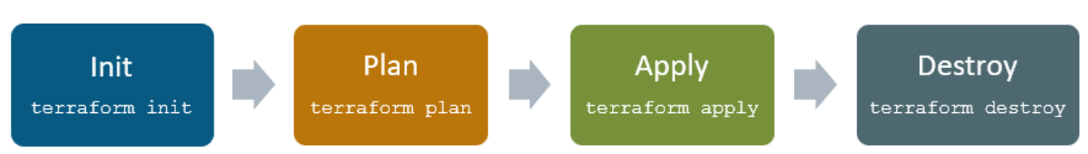
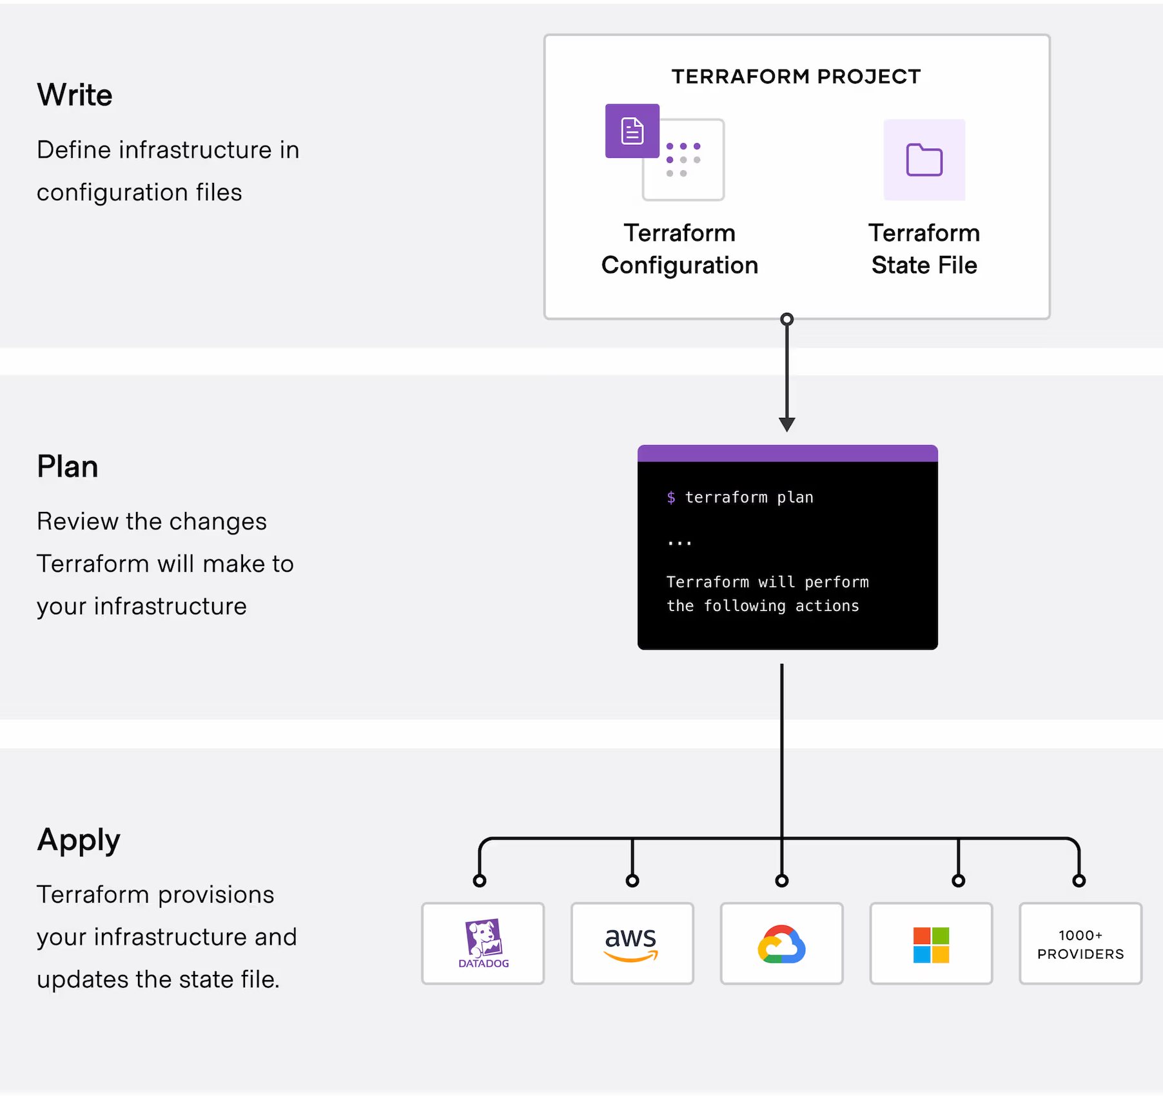
How Terraform Works?
RECAP
The core Terraform workflow consists of three stages:
Terraform init initializes the (local) Terraform environment. Usually executed only once per session.
Terraform plan compares the Terraform state with the as-is state in the cloud, build and display an execution plan. This does not change the deployment (read-only).
Terraform apply executes the plan. This potentially changes the deployment.
Terraform destroy deletes all resources that are governed by this specific terraform environment.
Notes:
Write: You define resources, which may be across multiple cloud providers and services. For example, you might create a configuration to deploy an application on virtual machines in a Virtual Private Cloud (VPC) network with security groups and a load balancer.
Plan: Terraform creates an execution plan describing the infrastructure it will create, update, or destroy based on the existing infrastructure and your configuration.
Apply: On approval, Terraform performs the proposed operations in the correct order, respecting any resource dependencies. For example, if you update the properties of a VPC and change the number of virtual machines in that VPC, Terraform will recreate the VPC before scaling the virtual machines.

Slide 6
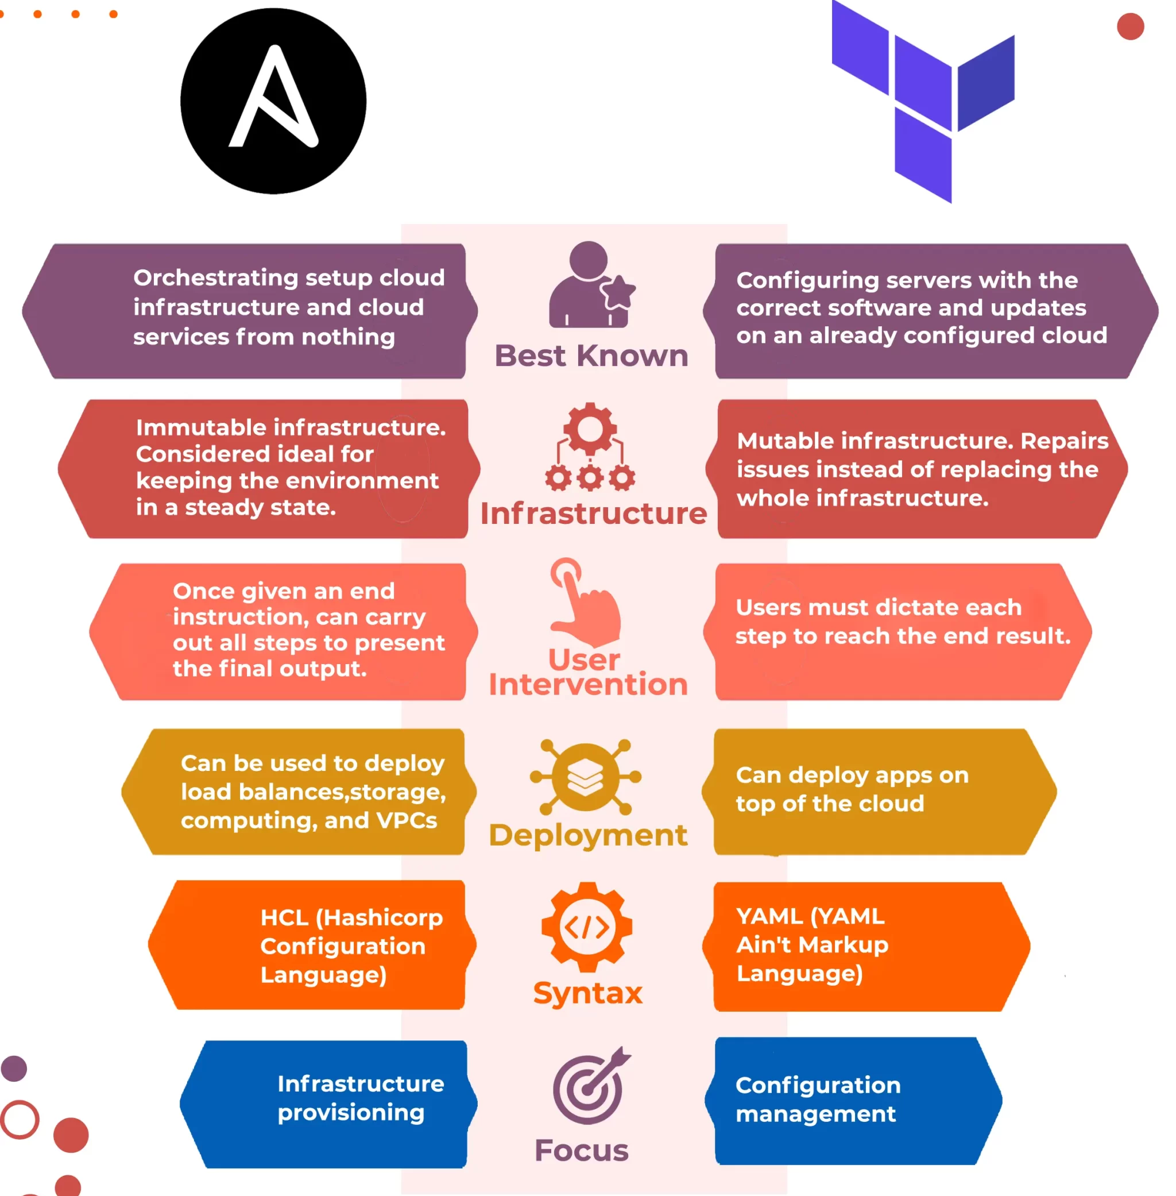
Ansible + Terraform
RECAP
Check This Video (Red Hat)
https://www.youtube.com/watch?v=vQSDWa8MlN8
NetworkChuck (Ansible)
https://www.youtube.com/watch?v=5hycyr-8EKs
John Hammond (Terraform)
https://www.youtube.com/watch?v=a3vVUiLzm8w

Slide 7
Learning Outcomes of Week #8
Understanding the key concepts of Service Monitoring.
Get familiar with Zabbix and How it can monitor different types of systems and service.
Explore Zabbix web-interface and monitor a Linux host using zabbix-agent.
Understanding SNMP protocol and its applications.
Gain hands-on experience on setting up an SNMP agent on a Linux host.
Describe Syslog as a system logging protocol and its components.
Learn how to setup an Rsyslog agent to send/receive logs from a Linux host.

Slide 8

Monitoring an IT Infrastructure
🛡 Ensure System Reliability – Detect and prevent failures before they impact operations.
📊 Performance Optimization – Identify bottlenecks and optimize resource utilization.
⚠ Early Threat Detection – Spot security vulnerabilities and respond to anomalies in real time.
💰 Cost Efficiency – Reduce downtime and optimize IT spending by identifying inefficiencies.
📉 Minimize Downtime – Proactive monitoring helps avoid costly service disruptions.
📜 Compliance & Auditing – Maintain logs and reports to meet regulatory requirements.
📈 Capacity Planning – Predict future growth and scale infrastructure accordingly.
🔍 Root Cause Analysis – Quickly identify and troubleshoot system issues.
Network
Operation
Center
Security
Operation
Center

Slide 9
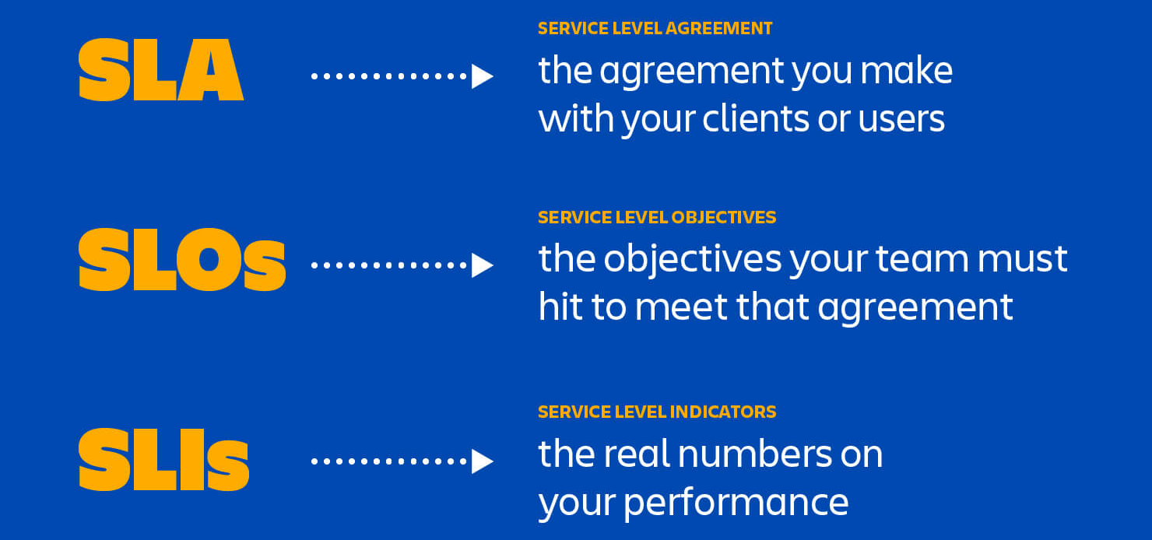
Metrics for Service Monitoring
There are several known metrics that help to define service Reliability, Availability, and Disaster Recovery strategies.
SLO (Service Level Objective)
A targeted performance goal used internally by service teams.
Defines desired service levels (Latency < 100ms, or Uptime > 99.95%).
SLA (Service Level Agreement)
A formal contract between a service provider and a customer.
Defines minimum service guarantees (e.g., 99.99% uptime).
Includes penalties if the provider fails to meet commitments.

Slide 10
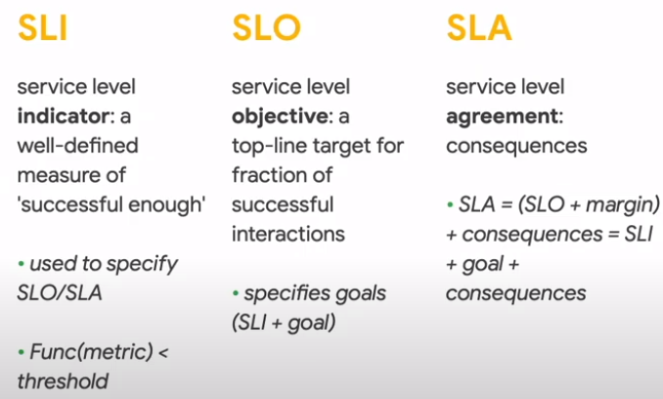
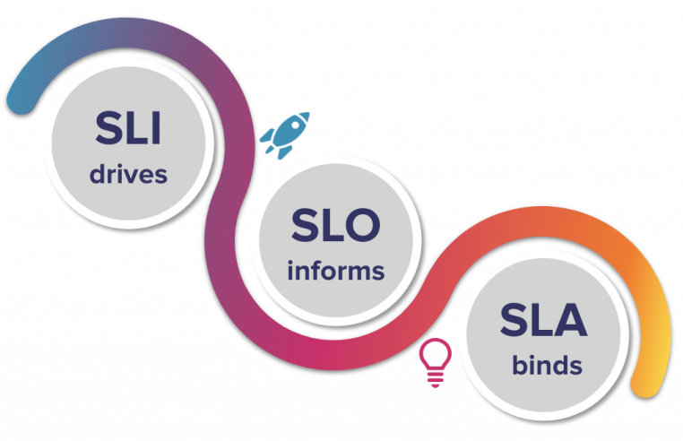
Metrics for Service Monitoring
There are several known metrics that help to define service Reliability, Availability, and Disaster Recovery strategies.
SLO (Service Level Objective)
A targeted performance goal used internally by service teams.
Defines desired service levels (Latency < 100ms, or Uptime > 99.95%).
SLA (Service Level Agreement)
A formal contract between a service provider and a customer.
Defines minimum service guarantees (e.g., 99.99% uptime).
Includes penalties if the provider fails to meet commitments.
SLI: current measured API latency is 160ms
SLO: internal target latency < 150ms
SLA: guaranteed max latency to customer is < 170ms
There will be a penalty & legal action for breach of SLA

Slide 11
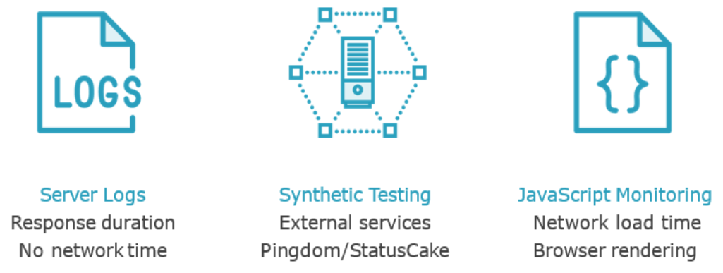
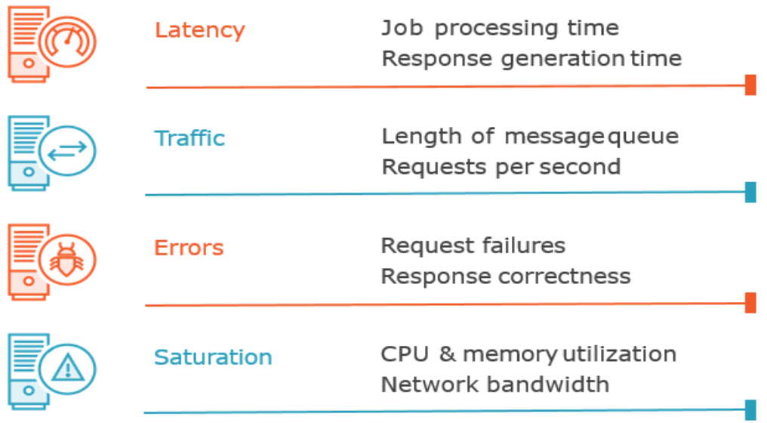
Metrics for Service Monitoring
Four Golden Signals

Slide 12

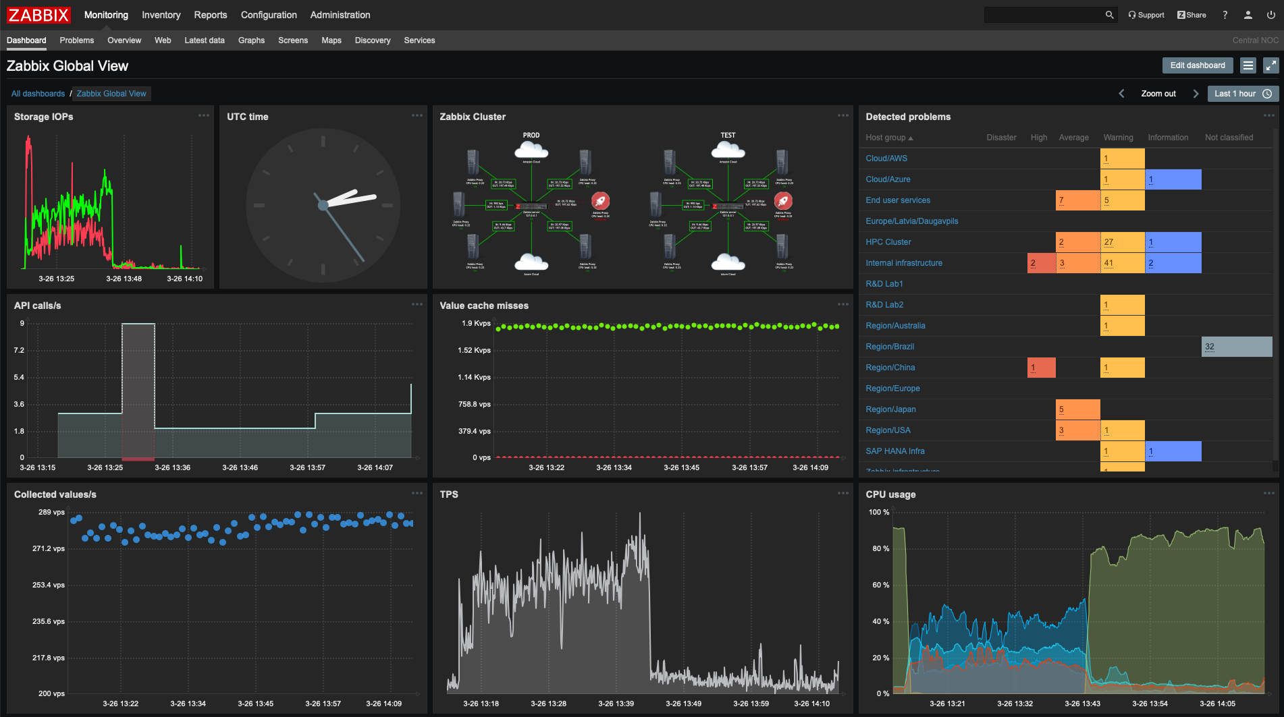
Monitoring an IT Infrastructure
Zabbix is an open-source, enterprise-level monitoring solution that provides real-time insights into networks, servers, and applications.
https://www.zabbix.com
Let’s visit this link to get a better understanding about Zabbix features ➔
https://www.zabbix.com/features

Slide 13
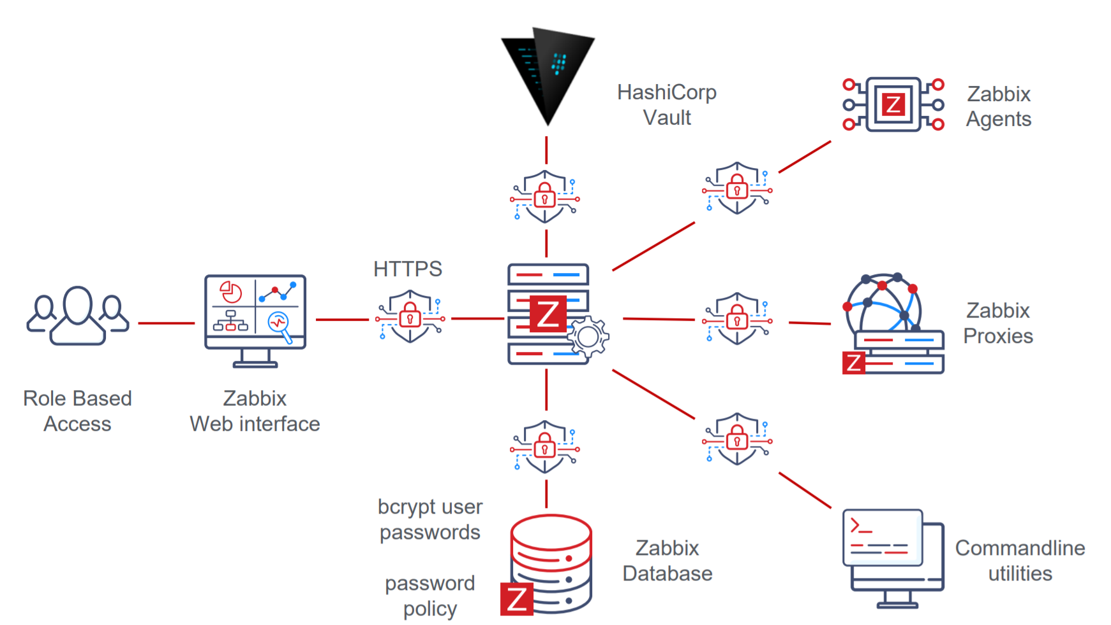
Monitoring an IT Infrastructure
Zabbix Structure
https://www.zabbix.com

Slide 14

Create a Zabbix Container
1
Install docker and docker compose on your Linux VM. https://github.com/5tuxnet/courses/blob/main/comp4912/lab5/zabbix-mariadb/docker_install.sh
Download docker-compose.yaml file from GitHub and copy that under a folder named ~/zabbix in your home directory. https://github.com/5tuxnet/courses/blob/main/comp4912/lab5/zabbix-mariadb/docker-compose.yaml
Run ‘docker-compose up –d’ inside ~/zabbix directory.
Verify docker containers are running via ‘docker ps’ and ensure port 8080 TCP is in LISTENING state using ‘netstat –nltup’.
Run ‘hostname –I’ command on your Linux VM to find the IP address which is accessible.
Open your browser and try access http://<IP address>:8080. To login the page, use admin/zabbix as credential.
Create an EC2 instance in AWS and install a Zabbix agent on it. Then, add this host into your Zabbix server to be monitored.

Slide 15
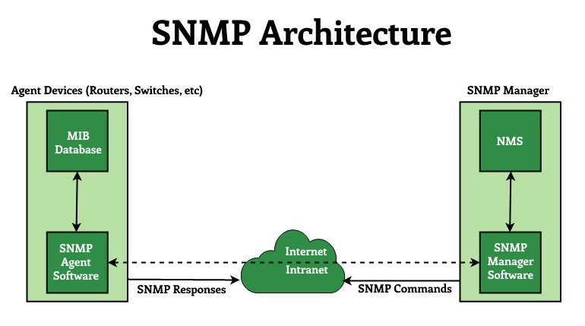
SNMP Protocol
SNMP (Simple Network Management Protocol) is a standard that helps network devices communicate and share management data. It is commonly used to monitor and control network components.
SNMP sends messages to network devices using SNMP agents.
These messages are called SNMP Get-Requests.
SNMP uses the User Datagram Protocol (UDP) to send messages.
SNMP Management Information Bases (MIBs) define what can be collected from a device.
Why SNMP is important?
SNMP helps to ensure a network is running with no issue.
It allows network engineers to gather information about network equipment.
It's compatible with most network devices, including routers, switches, servers, and firewalls.
SNMP Agent
SNMP Manager
Managed Devices
Management Information Base (MIB)
Notes:
SNMP Manager: Queries and receives data
SNMP Agent: Resides on devices, responds to requests
Managed Devices: Network devices with SNMP agent installed
Management Information Base (MIB): Database structure for monitoring data

Slide 16
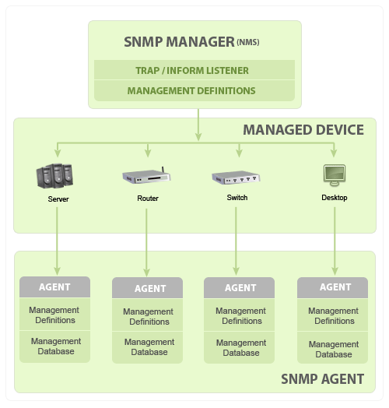
Basic SNMP Communication Diagram
https://www.manageengine.com/network-monitoring/what-is-snmp.html
Notes:
The agent is a program that is packaged within the network element. Enabling the agent allows it to collect the management information database from the device locally and makes it available to the SNMP manager, when it is queried for. These agents could be standard (e.g. Net-SNMP) or specific to a vendor (e.g. HP insight agent)

Slide 17
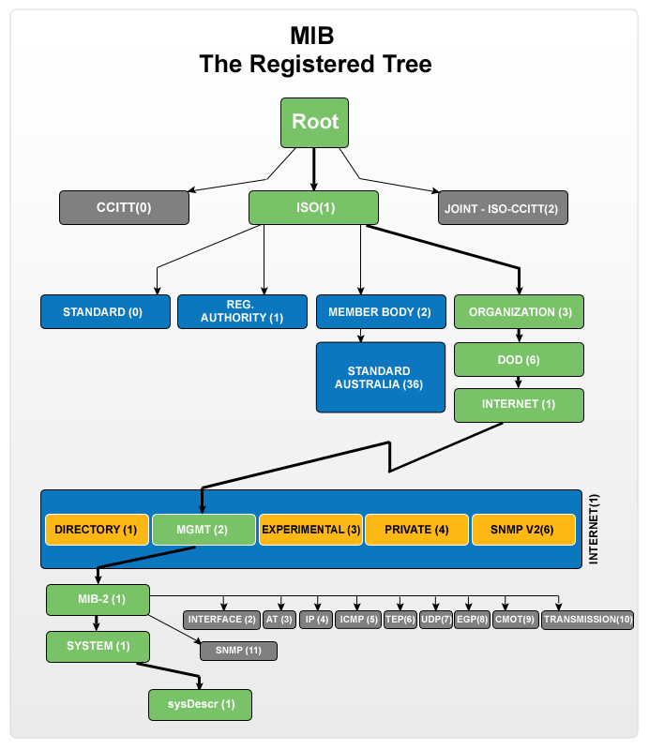
SNMP Hierarchy
To provide flexibility and extensibility, SNMP doesn’t require network devices to exchange data in a rigid format of fixed size. Instead, it uses a Tree-like format, under which data is always available for managers to collect
Multiple tables, referred to as Management Information Bases or MIBs, make up the data tree (or branches, if we stick with the tree metaphor). Each MIB groups together specific types of devices or device components. They have a unique identifying number and string, which can be used interchangeably, similar to how IP and hostnames used.
Each MIB consists of one or more nodes, which represent individual devices or device components on the network. In turn, each node has a unique Object Identifier (OID). The OID for a given node is determined by identifier of the MIB on which it exists combined with node’s identifier within its MIB.
MIBs are a Logical Grouping for OIDs.
MIB: Hierarchical database of network objects
OID: Unique identifier for each managed object
1.3.6.1.2.1.1.1.0 → OID for System description
https://www.manageengine.com/network-monitoring/what-is-snmp.html
Notes:
This means OIDs take the form of a set of numbers or strings (again, you can use these interchangeably).

Slide 18
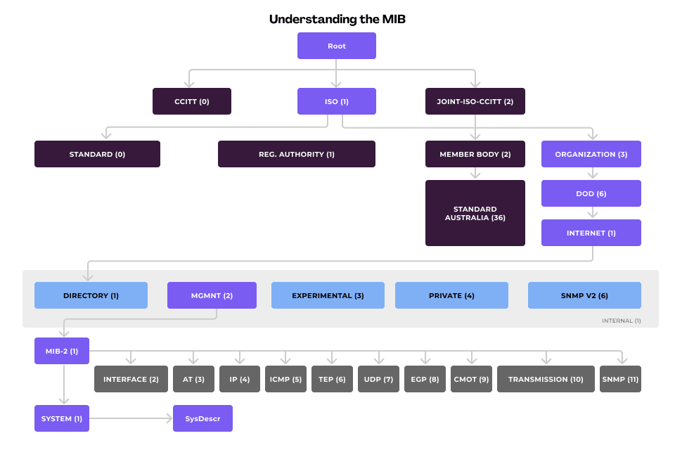
SNMP Hierarchy
https://www.auvik.com/franklyit/blog/network-basics-what-is-snmp/
Notes:
Breakdown of the Diagram:
1. Root Level
The Root is the top-most node in the hierarchy.
2. Primary Categories
From the Root, the hierarchy branches into three main categories:
CCITT (0): Represents telecommunication standards.
ISO (1): International Organization for Standardization.
JOINT-ISO-CCITT (2): A combination of ISO and CCITT.
Under ISO (1), the structure further breaks into:
Standard (0)
Registration Authority (1)
Member Body (2)
Organization (3) → DOD (6) → Internet (1)
3. Internet MIB Structure
From Internet (1), the hierarchy further branches into:
Directory (1)
Management (2)
Experimental (3)
Private (4)
SNMPv2 (6)
Internal (1)
The Management (2) section is key in SNMP as it contains MIB-2 (1), which is widely used in network management.
4. MIB-2 and Subcategories
MIB-2 (1) is a core part of SNMP and contains subcategories for different network protocols:
System (1) (e.g., SysDescr)
Interface (2)
Address Translation (AT) (3)
IP (4)
ICMP (5)
TCP (6)
UDP (7)
EGP (8)
CMOT (9)
Transmission (10)
SNMP (11)
This hierarchy is part of the SNMP MIB, which defines different objects that can be monitored and managed in a network. The MIB-2 (1) branch is particularly important for managing networking devices, as it provides information on system attributes, interfaces, IP, and transport protocols.

Slide 19
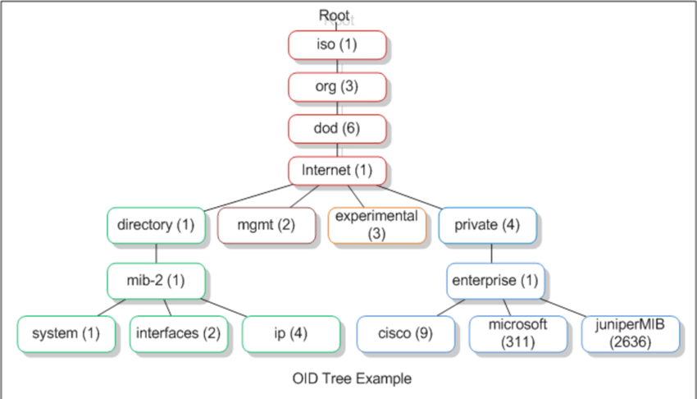
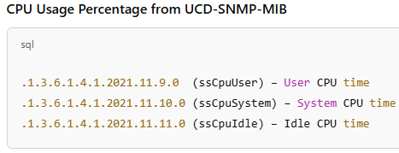
SNMP Hierarchy
This hierarchy also provides an easy, flexible way to organize many devices across a network.
It works no matter how large or small the network is, or what kind of devices are on it.
SNMP also makes it possible to collect large amounts of information quickly without clogging the network with traffic. Information about device status is always available in a simple format and is updated in real-time. This means SNMP managers can pull it without waiting for the data to be collected or requiring large data transfers.
Some OID values are vendor-specific, which makes it easy to gain some information about a device based simply on its OID.

Slide 20
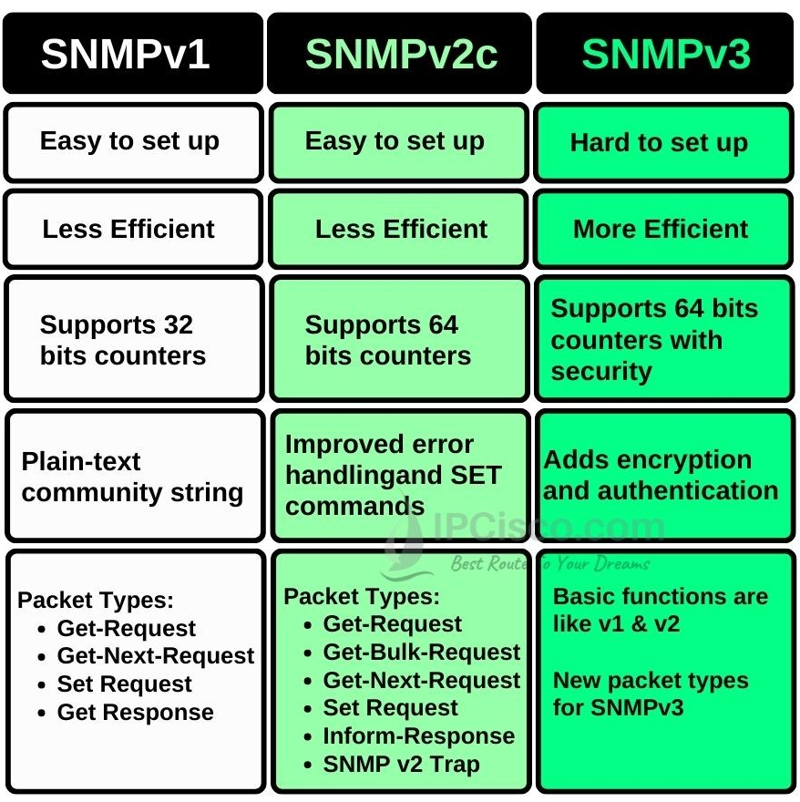
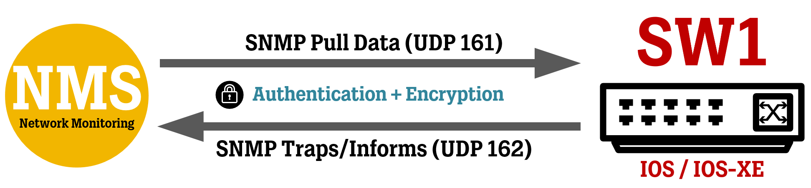
SNMP Versions
SNMP comes in three versions: SNMPv1, SNMPv2c, and SNMPv3.
SNMPv3 is the most Secure version.
SNMPv1: Basic functionality, no security.
SNMPv2c: Improved performance, still uses community strings.
SNMPv3: Security enhancements (Authentication & Encryption).

Slide 21
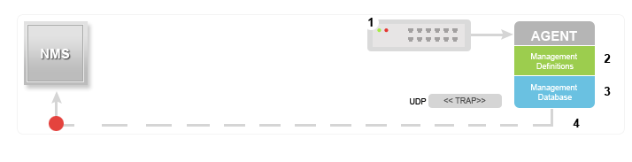
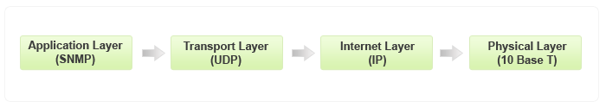
SNMP Trap
Event-driven Communication through SNMP Traps, providing real-time updates about network events to management systems. SNMP Traps are sent from Agent to Manager when an event occurs. Indeed, they are unsolicited messages and will be generated at events like Link Failure, High CPU Usage, Interface Goes Down.

Slide 22
Create a Zabbix Container
2
Create a new EC2 instance (using Ubuntu image) and install SNMP Agent on the host.
$ sudo apt update
$ sudo apt install snmpd libsnmp-dev
$ sudo apt install net-tools
$ netstat –nltup | grep 161 → Check 161 UDP is Listening
$ sudo systemctl stop snmpd
$ sudo net-snmp-create-v3-user -ro -A 'mypassword!' -X 'mypassword#' -a SHA -x AES snmpv3user
$ sudo vim /etc/snmp/snmpd.conf
=> set value for agentAddress udp:161,udp6:[::1]:161
$ sudo systemctl start snmpd
$ sudo systemctl status snmpd
On your Linux VM (WSL), run ‘curl ifconfig.me’ to get its Public IP address to access Internet.
Add this IP into the Security Group of your EC2 instance and Allow port 161 UDP.
From your Linux VM, run the following snmpwalk command.
=> $ snmpwalk -v3 -u snmpv3user -l authPriv -a SHA -A 'mypassword!' -x AES -X 'mypassword#' <EC2 instance public IP>
In your Zabbix server (running on Linux VM as a container), add the EC2 host using ‘Linux by SNMP’ template.
Configure SNMPv3 for this host based on the user you created in Step 1.
When adding the SNMPv3 details, don’t set any value for Context Name (just Security Name is enough).
Check the items (OIDs) created from the ‘Linux by SNMP’ template in your Zabbix.

Slide 23
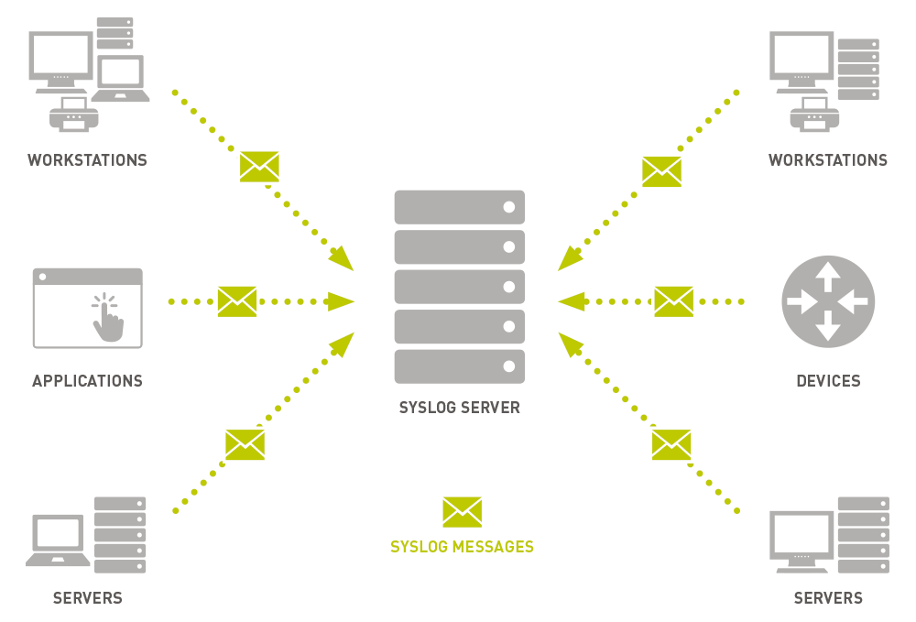
Syslog
Syslog is a standard protocol for Logging System Messages.
It allows Applications and Systems to send logs to a Centralized Location.
Used for Monitoring, Troubleshooting, and Security analysis.
Components of Syslog
Log Generators – Applications/System processes that create logs.
Syslog Daemon - Manages log processing and forwarding .
Log Storage/Server - Collects and stores logs centrally for analysis.
Syslog Message Format
Priority (PRI) - Severity and facility level.
Timestamp - When the log was generated.
Hostname - The system that sent the log.
Application name - Source of the message.
Message Content - The actual log details.
<34> Mar 8 10:15:22 myserver sshd[1234]: Failed login attempt

Slide 24
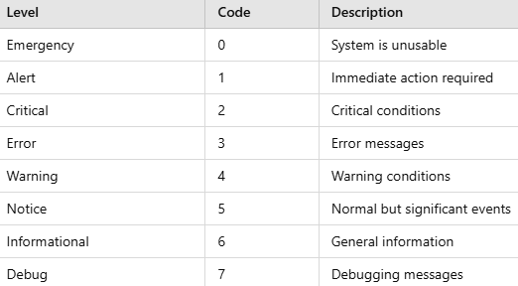
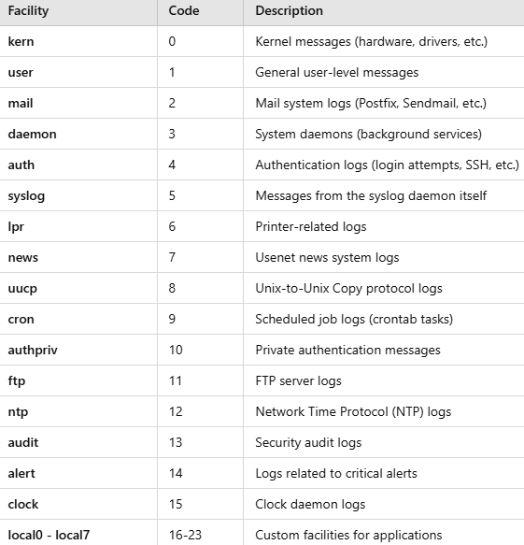
Syslog
Syslog Severity Levels
Syslog Facilities (indicates which process created the message)
Benefits of using Syslog
🔹 Security Monitoring - Detecting unauthorized access attempts. 🔹 Performance Monitoring - Tracking system performance logs. 🔹 Network Management - Monitoring router and firewall logs. 🔹 Compliance & Auditing - Ensuring compliance with security policies.
https://www.rsyslog.com/doc/index.html
https://github.com/rsyslog/rsyslog

Slide 25
Create a simple Syslog server
3
In your last EC2 instance, check rsyslog is installed and running. If it is not then, run:
$ sudo apt update && sudo apt install rsyslog
2. Open /etc/rsyslog.conf file and uncomment the following lines:
module(load="imudp")
input(type="imudp" port="514")
3. Next, you need to specify where the logs should be stored. In our example, it will be in a text file (/var/log/remote_logs.log).
Create a file named /etc/rsyslog.d/remote.conf and add the following line into it.
if $fromhost-ip != '127.0.0.1' then /var/log/remote_logs.log
4. Restart the rsyslog service by running ‘systemctl restart rsyslog’.
5. Ensure inbound traffic for Port 514/UDP is allowed for your EC2 instance (by adding it into the Security Group).
6. In your syslog client (Linux VM), open ‘/etc/rsyslog.conf’ file and append the following line to the end of the file.
*.* @<Server IP>:514 => replace the <Server IP> with the Public IP address of your instance.
7. Restart rsyslog daemon on your syslog client and sent a test message by running following commands:
$ sudo systemctl restart rsyslog && logger “Test message from Client…”
8. On your EC2 instance as rsyslog server, run ‘tail –f /var/log/remote_logs.log’ to see incoming logs.
9. Try to SSH to your syslog client (Linux VM) from your own computer and enter wrong passwords!
10. You should be able to see reported ‘Authentication Failures’ logs in remote_logs.log file at your syslog server.

Slide 26
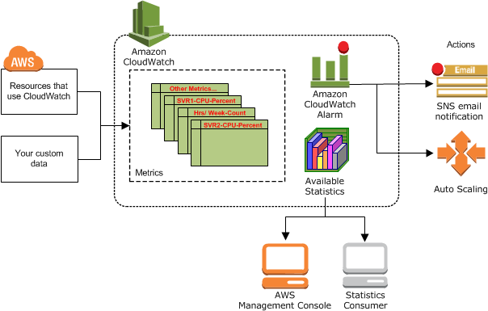
Amazon CloudWatch
https://docs.aws.amazon.com/AmazonCloudWatch/latest/monitoring/WhatIsCloudWatch.html

Slide 27
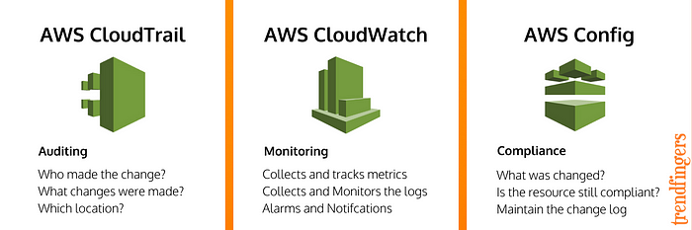
AWS CloudWatch/CloudTrail/Config

Slide 28


End of Lecture #8
THANK Y☺U
- Dawood Sajjadi

